Slide 1
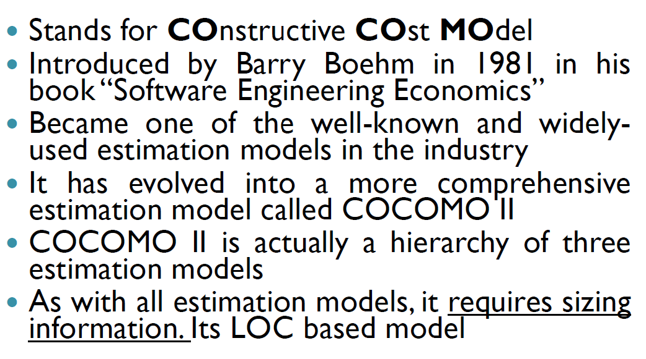
COCOMO II Model

Slide 2
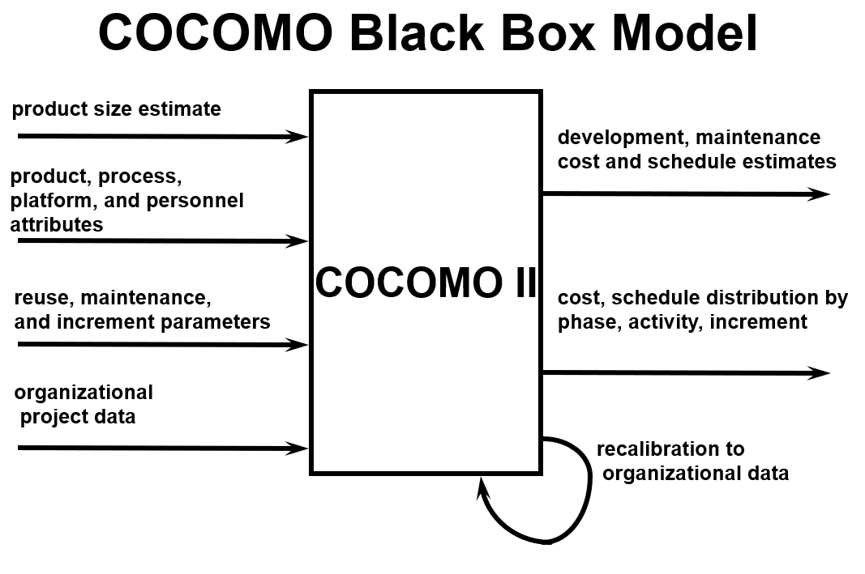

Slide 3
COCOMO-II
It addresses the following areas:-
a) Application Composition Model
b) Early design stage Model
c) Post architecture stage Model

Slide 4
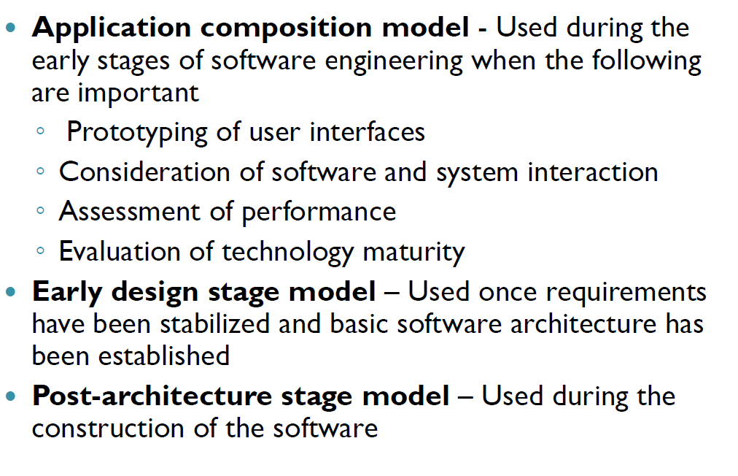
Contd…

Slide 5
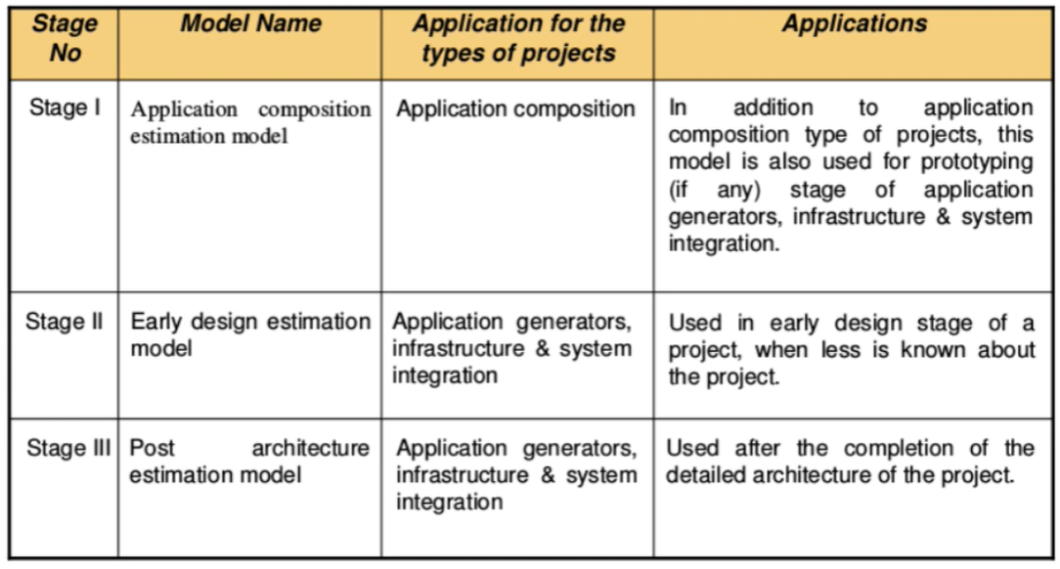

Slide 6
COCOMO-II
Three different software sizing options:-
a) Function Points
b) Lines of Source Code
c) Object Points

Slide 7
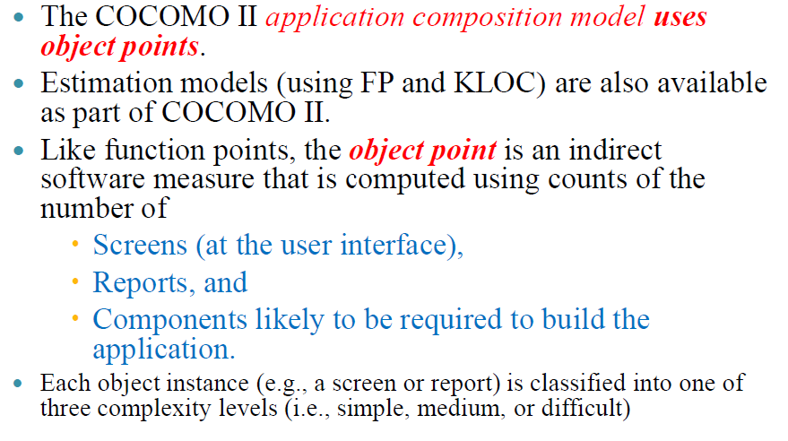

Slide 8
Contd…
Step-1
Object Point is computed using count of:
Number of screens
Reports
Components likely required to build the application
Step-2
Each object instance like screen or report is classified into complexity levels
a) Simple
b) Medium
c) Difficult

Slide 9
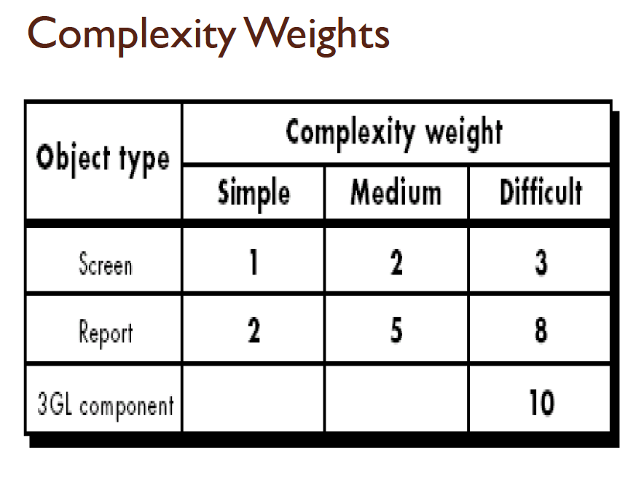

Slide 10
Contd…
Step-3
After complexity is determined, the no. of screens, reports and components are weighted according table
Step-4
Object Point calculation is done
Obj. point= Σ [Original No. of Object Instances * Weighting Factor]

Slide 11
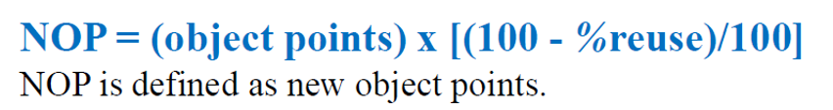


Contd…
Step 5: If the software is going to be reused then:-
a) Percentage reused is calculated and
b) Object point is adjusted (NOP)
Now, productivity rate must be derived:
Productivity Rate:-
Estimated Effort:-

Slide 12
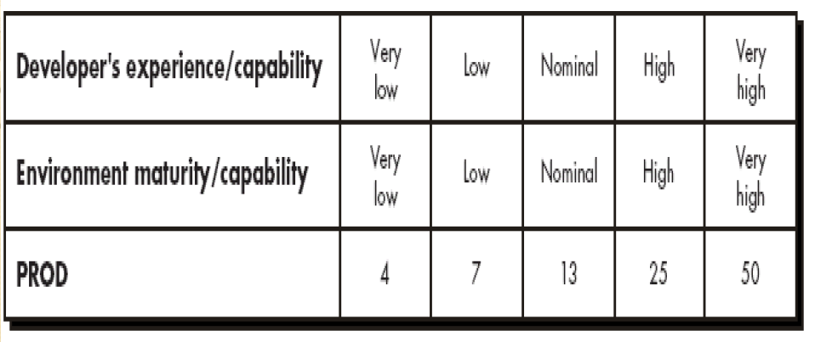
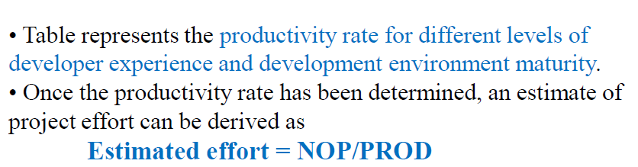

Slide 13
Contd…
Example: Compute the productivity, when it is given to you that the developers experience is high and environment maturity is high
Solution:
(Take the values from the table )
Developers experience is high = 25 (weight)
Environment maturity is high = 25( weight)
The required productivity is the average of two factors:
PROD=(25+25)/2 =50/2 = 25

Slide 14
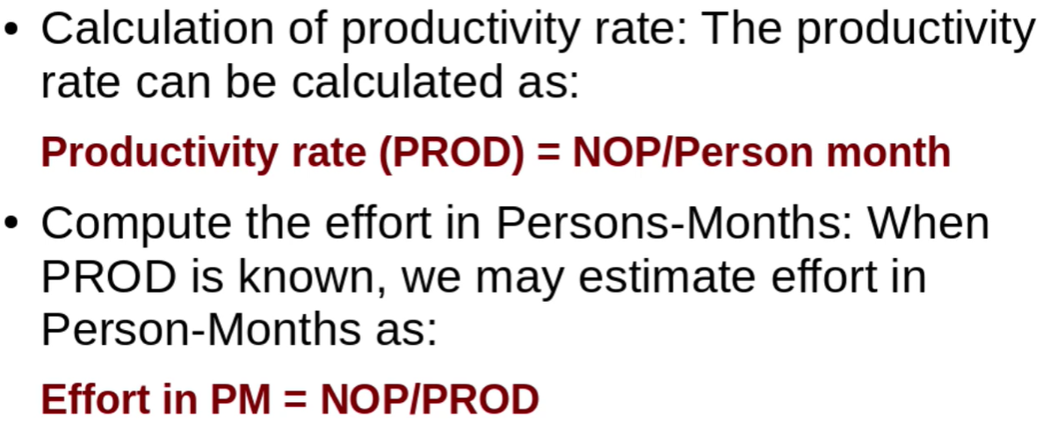
Step 6:

Slide 15
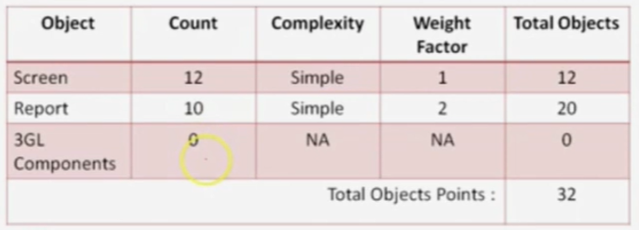
Example:
Use the COCOMOII model to estimate the effort required to build software for a simple ATM that produces 12 screen, 10 reports and will require approximate 80 % as new software components.
Assume average complexity and average developer/ environment maturity. Use application composition model with object points:
Solution:
Compute Productivity rate

Slide 16
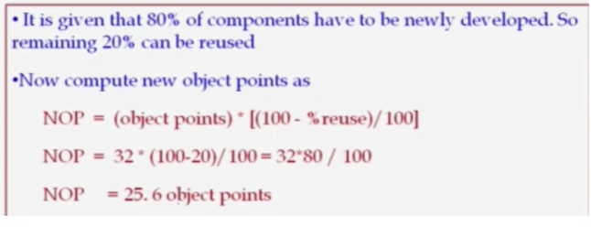
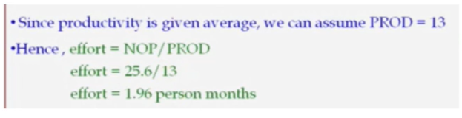
Contd…
Compute New Object Point(NOP)
Compute Effort

Slide 17
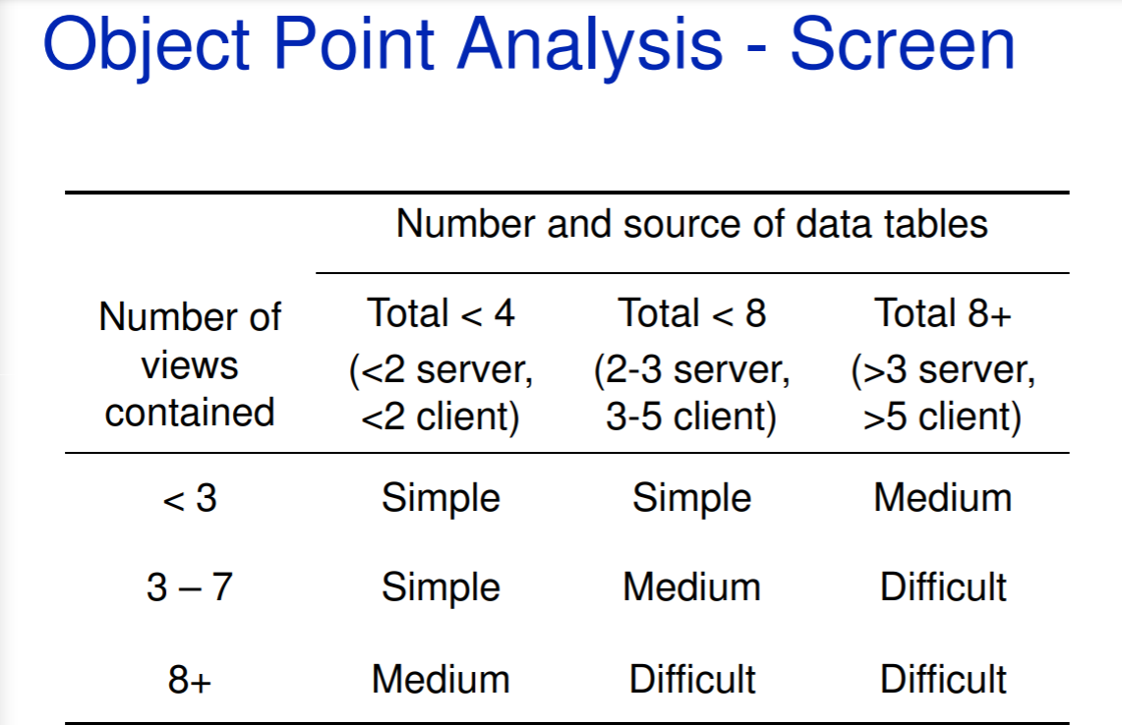

Slide 18
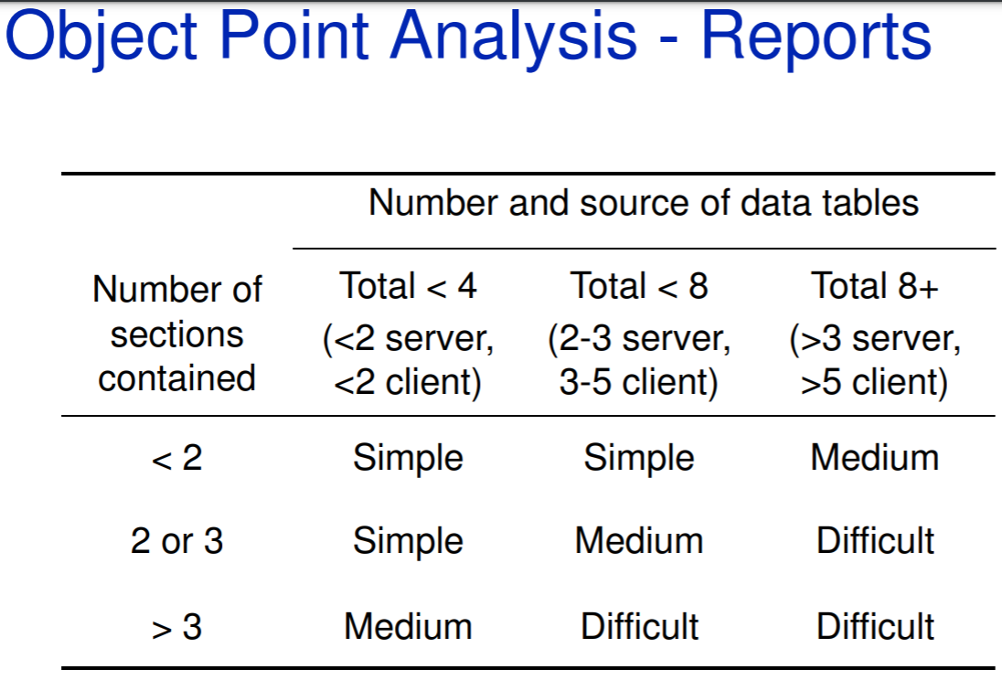

Slide 19
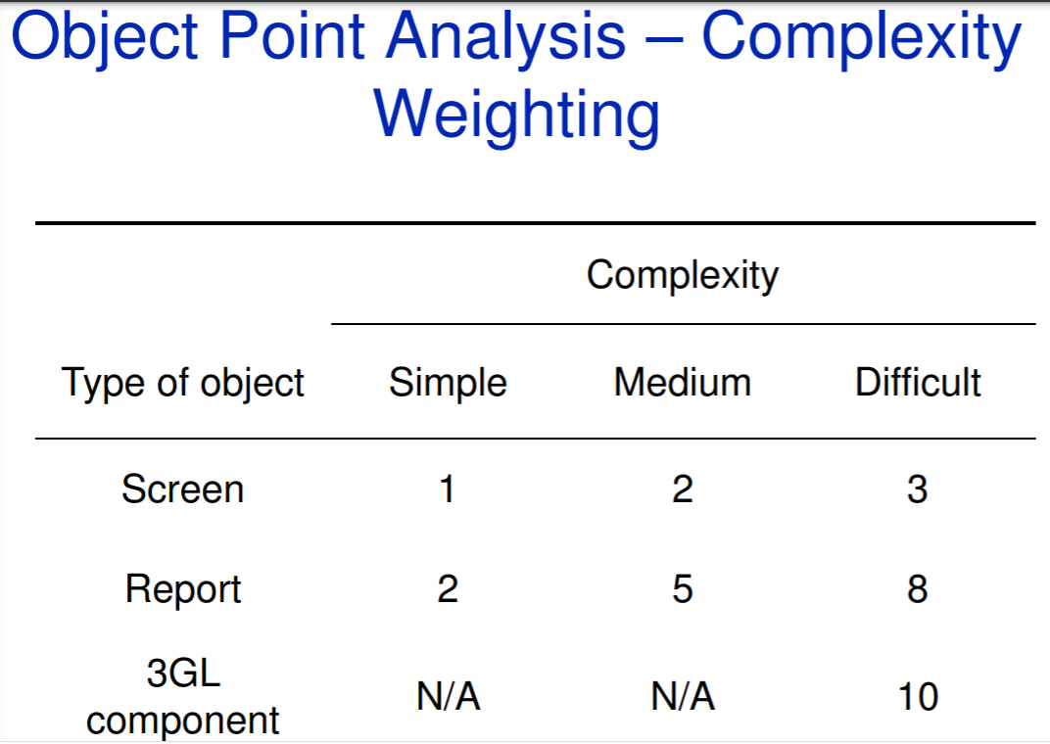

Slide 20
Revision:
Step-1: Access Object counts Estimate the number of screens, reports and 3GL components that will comprise this application.
Step-2: Classify complexity levels of each object We have to classify each object instance into simple, medium and difficult complexity level depending on values of its characteristics. Complexity levels are assigned according to the given table

Slide 21
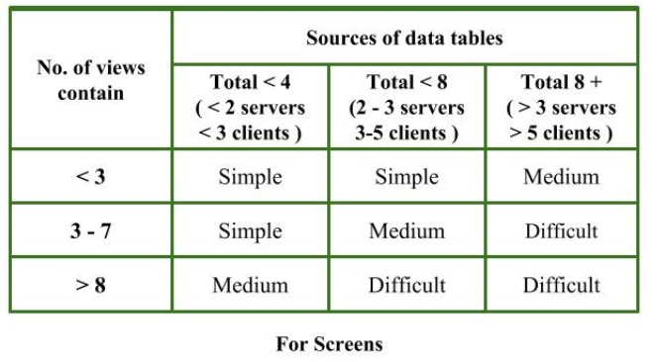
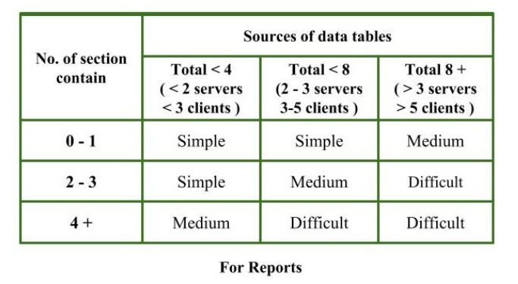
Contd…

Slide 22
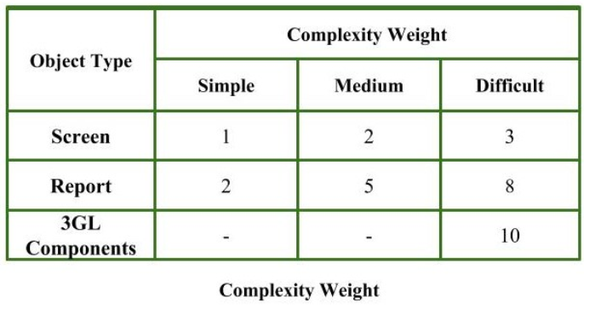
Contd…
Step-3: Assign complexity weights to each object The weights are used for three object types i.e, screens, reports and 3GL components. Complexity weight are assigned according to object’s complexity level using following table

Slide 23
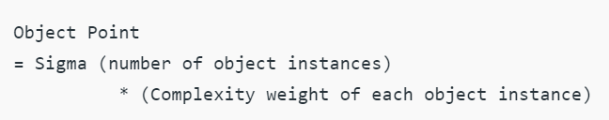

Contd…
Step-4: Determine Object Points Add all the weighted object instances to get one number and this is known as object point count.
Step-5: Compute New Object Points (NOP) We have to estimate the %reuse to be achieved in a project. Depending on %reuse
NOP are the object point that will need to be developed and differ from the object point count because there may be reuse of some object instance in project.

Slide 24
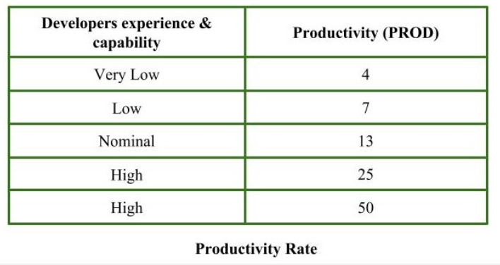
Contd…
Step-6: Calculate Productivity rate (PROD) Productivity rate is calculated on the basis of information given about developer’s experience and capability. For calculating it, we use following table

Slide 25

Contd…
Step-7: Compute the estimated Effort Effort to develop a project can be calculated as
Effort is measured in person-month.

Slide 26
Contd…
Example: Consider a database application project with
The application has four screens with four views each and seven data tables for three servers and four clients.
Application may generate two reports of six section each from seven data tables for two servers and three clients.
10% reuse of object points. Developer’s experience and capability in similar environment is low. Calculate the object point count, New object point and effort to develop such project.

Slide 27
Contd…
Step-1: Number of screens = 4 Number of records = 2
Step-2: For screens, Number of views = 4 Number of data tables = 7 Number of servers = 3 Number of clients = 4 by using above given information and table (For Screens), Complexity level for each screen = medium
For reports, Number of sections = 6 Number of data tables = 7 Number of servers = 2 Number of clients = 3 by using above given information and table (For Reports), Complexity level for each report = difficult

Slide 28
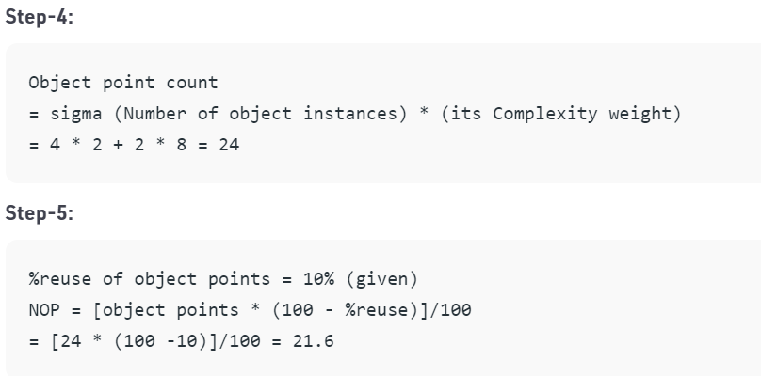
Contd…
Step-3: By using complexity weight table we can assign complexity weight to each object instance depending upon their complexity level. Complexity weight for each screen = 2 Complexity weight for each report = 8

Slide 29
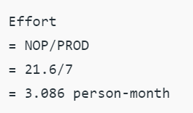
Contd…
Step-6: Developer’s experience and capability is low (given) Using information given about developer and productivity rate table Productivity rate (PROD) of given project = 7
Step-7:
Therefore, effort to develop the given project = 3.086 person-month.

Slide 30
